Slide 1
JobMatch AI: Smart Resume Generator with ATS Optimization

Slide 2




Team details
TEAM NAME: Turbo
Sudesh Patil (Team Leader)
Sudesh Patil
Photo

Slide 3
Entry Submission Summary
Idea Title (Provide a concise and impactful title for your idea.) | JobMatch AI: Smart Resume Generator with ATS Optimization Created an AI-Powered Resume Optimization for Building Next Gen Agentic App Hackathon.
Team Name | Turbo
Problem Statement | Problem Statement 5: Enhancing Job Screening with AI and Data Intelligence The recruitment process often involves manually reviewing numerous job descriptions (JDs) and CVs, which can be time-consuming and prone to human error. Job seekers often face the challenge of customizing their resumes to match specific job descriptions provided by different companies. Most resumes are generic and not aligned with the requirements mentioned in the job posting, resulting in poor ATS (Applicant Tracking System) scores and lower chances of being shortlisted. Manually tailoring each resume is time-consuming and inefficient, especially for candidates applying to multiple roles.
Proposed Solution | Agentic AI generates ATS-optimized resumes tailored to specific job descriptions of company that has opening. Users submit their details and job role, and the AI analyzes and matches their profile to the role, providing a custom resume, ATS score, and improvement suggestions. It also outputs a JSON resume and plans future auto-update integrations.

Slide 4
Problem statement you are trying to address
Job seekers often submit generic resumes that don’t align with specific job descriptions.
Low alignment results in poor ATS (Applicant Tracking System) scores and fewer interview calls.
Manually customizing resumes for each job is time-consuming and inefficient.Users struggle to keep resumes updated with recent projects, skills, and certifications.
There’s a need for an intelligent, automated system to generate targeted, high-quality resumes and keep them up to date.

Slide 5
Proposed Solution Overview
Brief approach description or methodology used to tackle the problem
To address the problem, we developed Agentic AI, an autonomous system that uses AI to analyze user-provided data—such as personal details, experience, certifications, and a specific job description. It applies NLP techniques to extract key requirements from the job post and maps them against the user’s profile. Based on this analysis, it generates an ATS-optimized resume tailored for that role, calculates an ATS score, and provides actionable suggestions (e.g., relevant projects, skills). The system outputs a structured JSON format of the resume. Future enhancements include GitHub and email integration for real-time resume updates and interview alerts.
User submits personal information, experience, certifications, and a specific job description from a company.
A personalized, ATS-optimized resume is generated using intelligent prompt chaining and agentic reasoning techniques.
The system provides an ATS score and actionable insights (skills, certifications, projects) to improve job alignment.
Resume is exported in JSON format, with future automation planned via GitHub and email integrations for continuous updates.

Slide 6
Technologies Used
List the key technologies, frameworks, and tools you utilized in your solution
Flask
Streamlit
Google Gemini API
Gemini based on-prem LLMs
LangChain
Agentic AI frameworks:- Agno
Flask-CORS
Fitz

Slide 7
Code structure
Agentic-Ai-Resume-builder/
│
├── .gitignore # Specifies files and directories to be ignored by Git
├── Resume_Optimizer.py # Main script for optimizing resumes
├── app.py # Streamlit application for user interaction
├── debug_input.json # Sample input data for debugging purposes
├── debug_processed.json # Processed data output for debugging
├── debug_resume.tex # LaTeX source file for debugging resume generation
├── latex_compile.log # Log file capturing LaTeX compilation details
├── requirements.txt # Lists Python dependencies required for the project
├── resume.pdf # Generated sample resume in PDF format
└── resume_template.tex # LaTeX template used for generating resumes

Slide 8
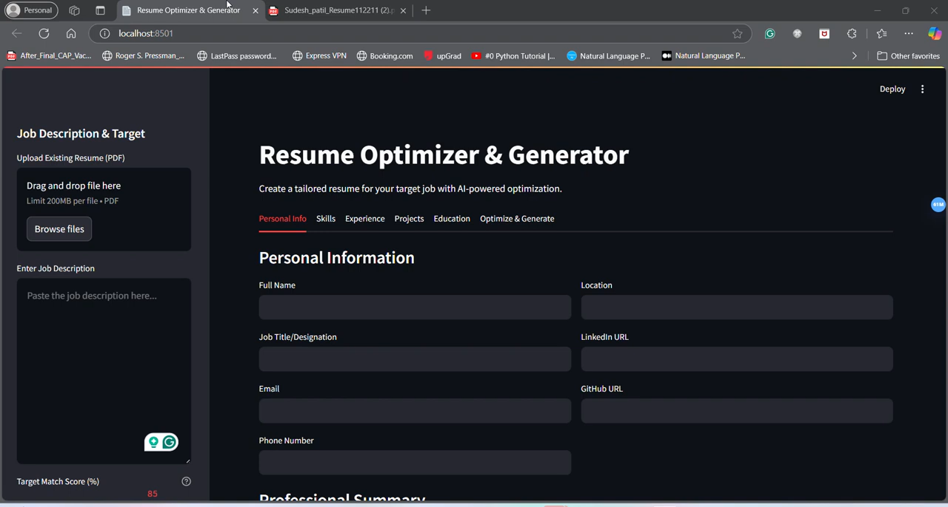
Demo video
https://www.youtube.com/watch?v=RRHHwmlU9do

Slide 9
Conclusion
Summarize the impact and effectiveness of your solution. Reiterate how it solves the problem statement.
The Agentic AI Resume Builder effectively addresses the challenge of aligning resumes with specific job requirements. By analyzing the job description and comparing it with the user’s profile, it generates a tailored, ATS-optimized resume along with a match score and actionable improvement insights. This not only increases the chances of shortlisting but also saves time and effort in resume customization. As the user grows, the system adapts—tracking new projects and skills to keep the resume up to date. Overall, it transforms the resume-building process into a smart, automated, and future-ready experience.

Slide 10
References/Other details
https://github.com/SudeshRPatil20/Agentic-Ai-Resume-builder
Demo Link:-
https://agentic-ai-resume-builder.streamlit.app/

Slide 11

Thank You

